Slide 1
Hierarchical Information Enhanced
Parking Availability Forecasting
Speaker: Qiongyan Wang
Supervisor: Yuxuan Liang
2024.10.13

Slide 2
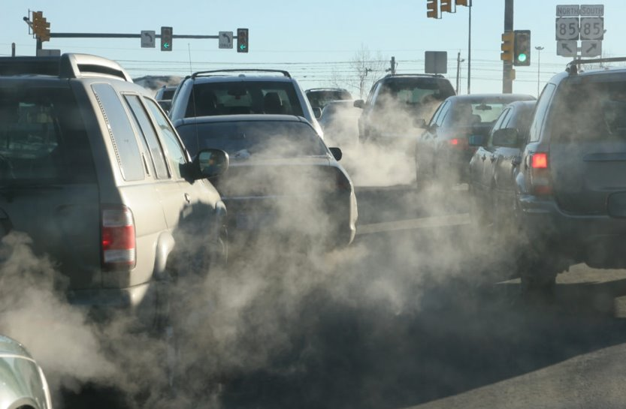
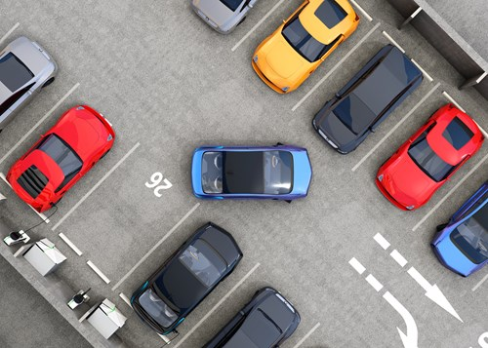

Background
Urban traffic congestion leads to air pollution and poses health risks.
Finding parking spaces is one of the main reasons for traffic congestion, which is more significant in densely populated countries such as Singapore.
An urgent need to achieve precise and efficient prediction of Parking Availability (PA) in Singapore.
Notes:
Let me first briefly introduce the background.(reading the slides)

Slide 3
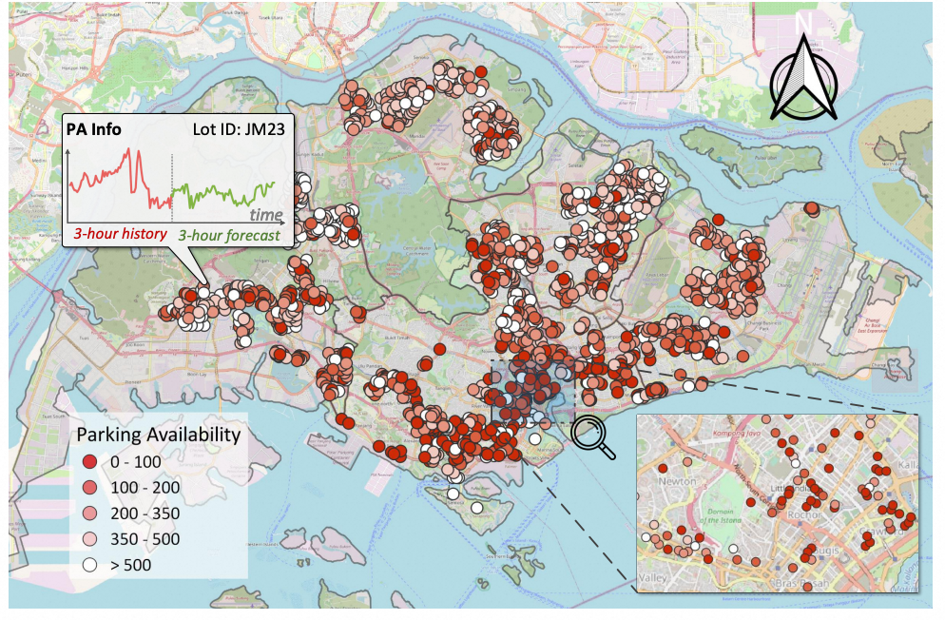
Problem definition

Slide 4
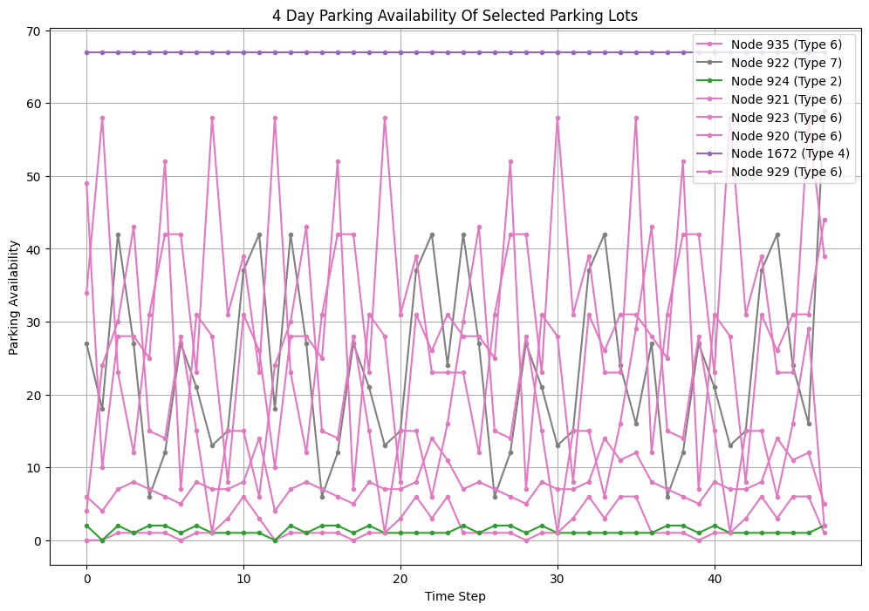
Challenges
Low predictability: The variation of a single parking lot is irregular and has low predictability.

Slide 5



Challenges
Spatial heterophily: The trend of vacancy changes in parking lots of the same type is similar, but the correlation between different types of parking lots is weak.

Slide 6

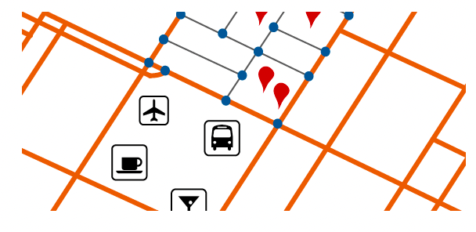
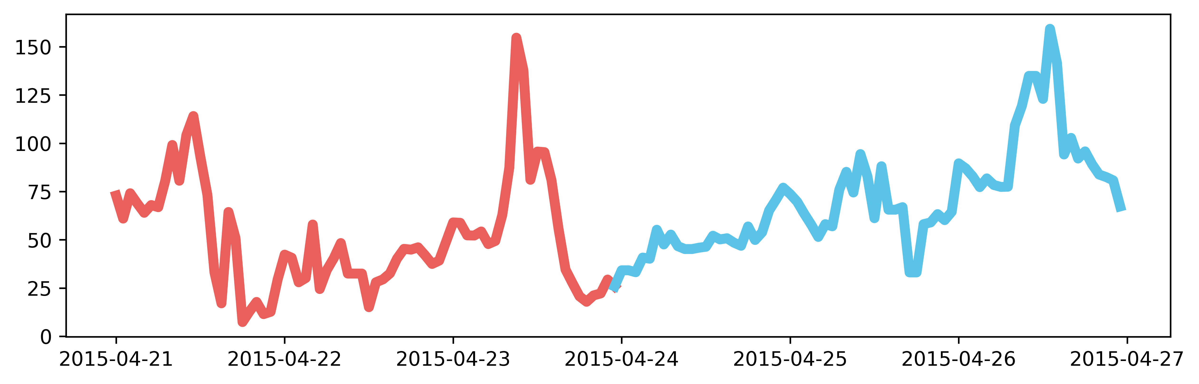
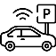


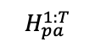
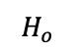
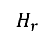
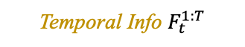
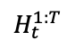
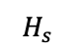

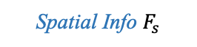
Methodology
Embedding
Ground Truth PA
$$H_{s}$$
Spatial Info $F_{s}$
$$H_{r}$$
Mapping
Mincut loss
MAE loss
Encoder
Concat
$$H_{pa}^{1:T}$$
$$H_{o}$$
History PA $X^{1:T}$
Predicted PA
Temporal
Learning
Predictor
Embedding
Hierarchical Net
$$H_{t}^{1:T}$$
Temporal Info $F_{t}^{1:T}$

Slide 7
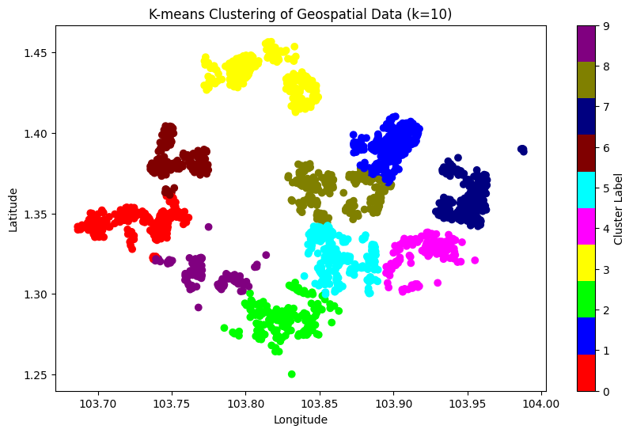
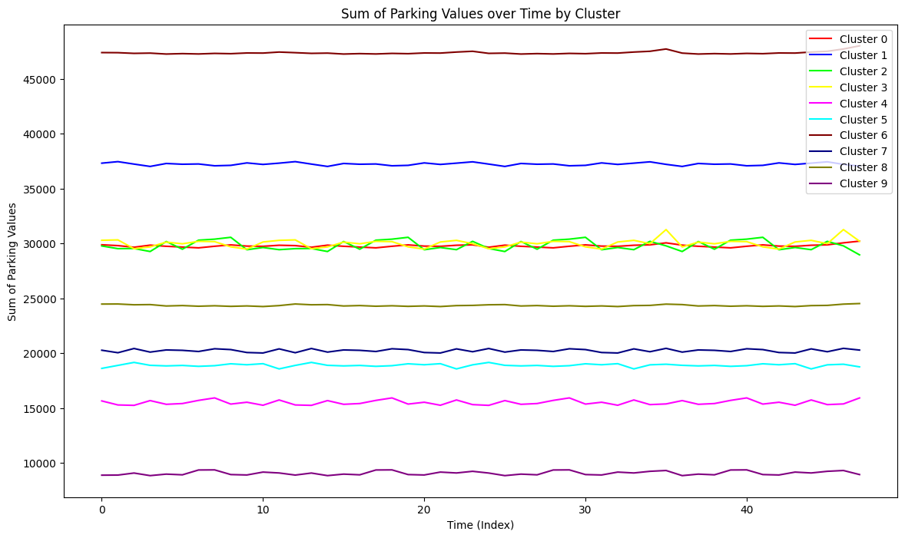
Methodology (Hierarchical Net)
The changes in parking spaces in a single parking lot fluctuate greatly, while the overall changes in parking spaces in an area are relatively stable

Slide 8
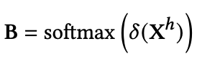
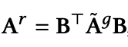
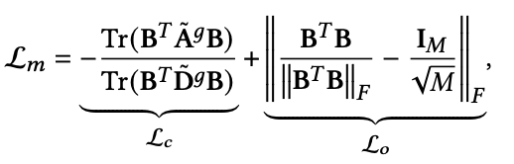
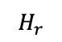
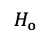
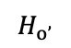
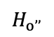
Methodology (Hierarchical Net)
Homophilic
GCN
$$H_{r}$$
Mapping
Fusion
Mlp
$$H_{o’’}$$
$$H_{o}$$
Heterophilic
GCN
$$H_{o’}$$
Hierarchical Net
Learnable Matrix:
Region-level Matrix:
Mincut Loss:
Notes:
Inspired by the Mincut theory that aims at partitioning nodes into disjoint subsets by removing the minimum volume of edges, we view each region as a cluster containing many nodes and regularize the assignment matrix by using a new loss.
1 how to increase predictability ()
2 how to capture the close

Slide 9
Methodology (Heterophilic GCN)
In a homophilic graph, neighboring nodes of a node typically have similar features or category labels.
In heterophilic graph, neighboring nodes of a node may have different features or category labels, which leads to a decrease in the performance of traditional homomorphic GCN models on these graphs.

Slide 10
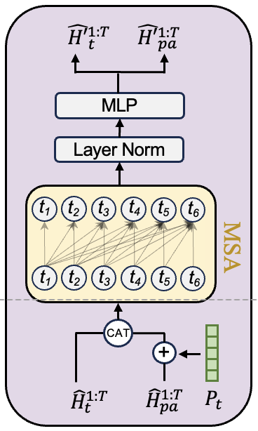
Methodology (Temporal Learning)

Slide 11
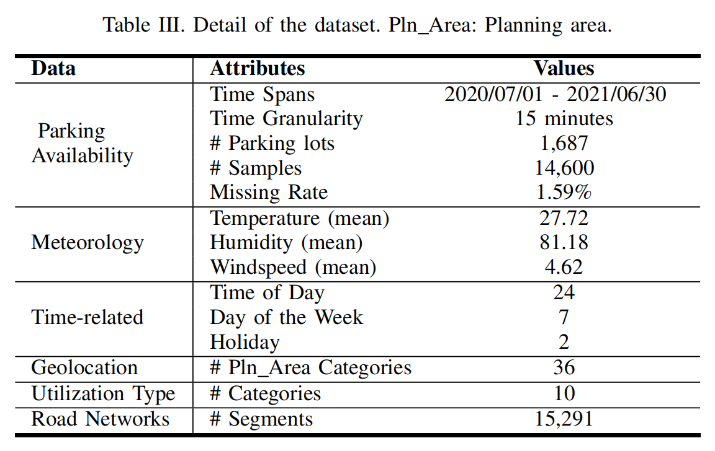
Experiment

Slide 12
Experiment
We predict PA over the next 12 steps given the past 12 steps, where each step stands for 15 minutes
Evaluation metrics: MAE, RMSE
Pre-defined region (K-means)
Learnable region (Hierarchical net)
Model | Average (1~12 steps) |  | 0-1h (1～4 steps) |  | 1-2h (5~8 steps) |  | 2-3h (9~12 steps)
 | MAE | RMSE | MAE | RMSE | MAE | RMSE | MAE | RMSE
DeepPA | 10.95 | 29.54 | 9.11 | 28.00 | 11.18 | 29.57 | 12.56 | 31.06
Pre-defined region | 12.27 | 30.46 | 9.45 | 28.09 | 12.37 | 30.33 | 14.98 | 32.99
Learnable region | 11.05 | 29.62 | 9.08 | 27.91 | 11.26 | 29.62 | 12.80 | 31.33

Slide 13
Thank You !
Speaker: Qiongyan Wang
2024.10.14

Slide 14

如何进行有效的区域划分 ( )
如何量化可预测性
怎么设计正则化项去使得可预测性加强
设计message passing (是映射回去还是vit local和global交互)( )
Graph pooling, hyper graph (. )

